Slide 1
Lecture 7: Spatio-temporal models
May 10, 2016

Slide 2
Multiple ways to include interactions
Arises for whenever there’s multiple factors
Include spatial effect (No / Yes)
Include temporal effect (No / Independent / Smoothed)
Include spatio-temporal effect (No / Independent / Smoothed)

Slide 3
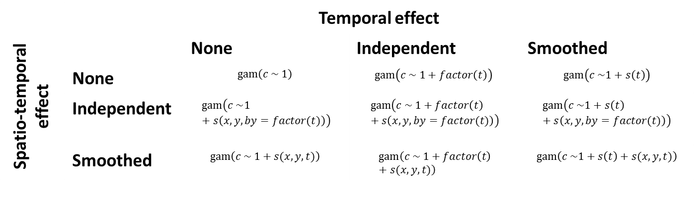
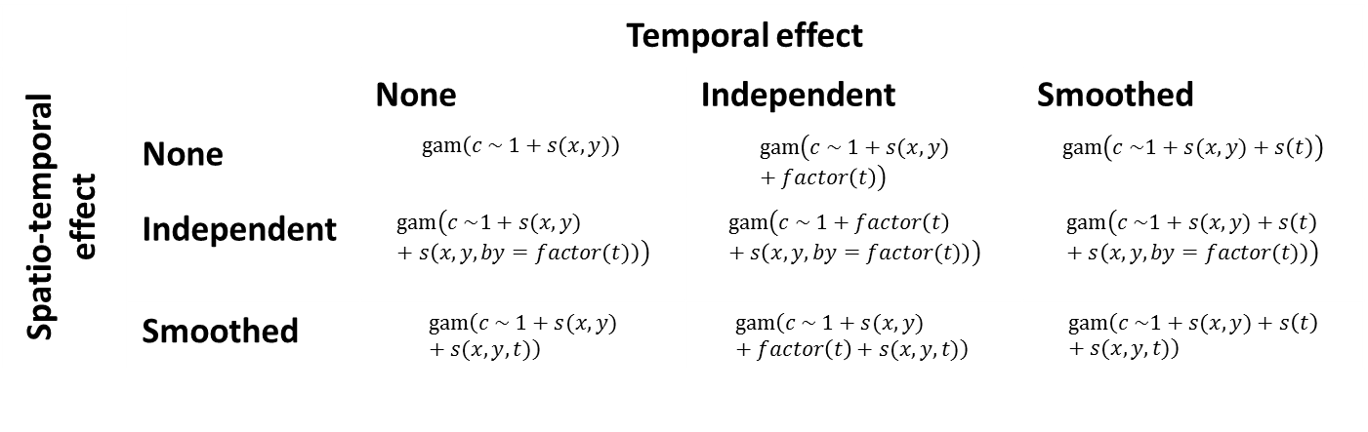
Without spatial
With spatial
 | Temporal effect
Spatio-temporal effect |  | None | Independent | Smoothed
 | None | $$gam\left(c \sim 1\right)$$ | $$gam\left(c \sim 1+factor\left(t\right)\right)$$ | $$gam\left(c \sim 1+s\left(t\right)\right)$$
 | Independent | $$gam\left(c \sim 1+s\left(x, y,by=factor(t)\right)\right)$$ | $$gam\left(c \sim 1+factor\left(t\right)+s\left(x, y,by=factor(t)\right)\right)$$ | $$gam\left(c \sim 1+s\left(t\right)+s\left(x, y,by=factor(t)\right)\right)$$
 | Smoothed | $$gam\left(c \sim 1+s(x,y,t)\right)$$ | $$gam\left(c \sim 1+factor\left(t\right)+s(x,y,t)\right)$$ | $$gam\left(c \sim 1+s\left(t\right)+s(x,y,t)\right)$$
 | Temporal effect
Spatio-temporal effect |  | None | Independent | Smoothed
 | None | $$gam\left(c \sim 1+s(x,y)\right)$$ | $$gam\left(c \sim 1+s(x,y)+factor\left(t\right)\right)$$ | $$gam\left(c \sim 1+s(x,y)+s\left(t\right)\right)$$
 | Independent | $$gam\left(c \sim 1+s(x,y)+s\left(x, y,by=factor(t)\right)\right)$$ | $$gam\left(c \sim 1+factor\left(t\right)+s\left(x, y,by=factor(t)\right)\right)$$ | $$gam\left(c \sim 1+s(x,y)+s\left(t\right)+s\left(x, y,by=factor(t)\right)\right)$$
 | Smoothed | $$gam\left(c \sim 1+s(x,y)+s(x,y,t)\right)$$ | $$gam\left(c \sim 1+s(x,y)+factor\left(t\right)+s(x,y,t)\right)$$ | $$gam\left(c \sim 1+s(x,y)+s\left(t\right)+s(x,y,t)\right)$$
Notes:
Think about if my stuff should be smoothed or independent – fishing sites, landings sites

Slide 4

Two we will focus on:
Spatial index standardization
$$gam\left(c \sim factor\left(t\right)+s(x,y)+s\left(x, y,by=factor(t)\right)\right)$$
Spatial Gompertz model
$$gam\left(c \sim 1+s(x,y)+s(x,y,t)\right)$$
Notes:
“data-wasteful” method of approaching this problem → independent spatial areas
Case 1 – model with data, things are bouncing around from year to year, want a model that can capture the variation
Maybe in a couple years, change in technology – not accounting for that explicitly in the model but want the model to reflect large changes in catch
Descriptive model, hard to interpret biologically
Case 2 – have dynamics where you can place some understanding of the biology occurring, more smoothly, more flexibility than Case 1 for incorporating biological piece

Slide 5
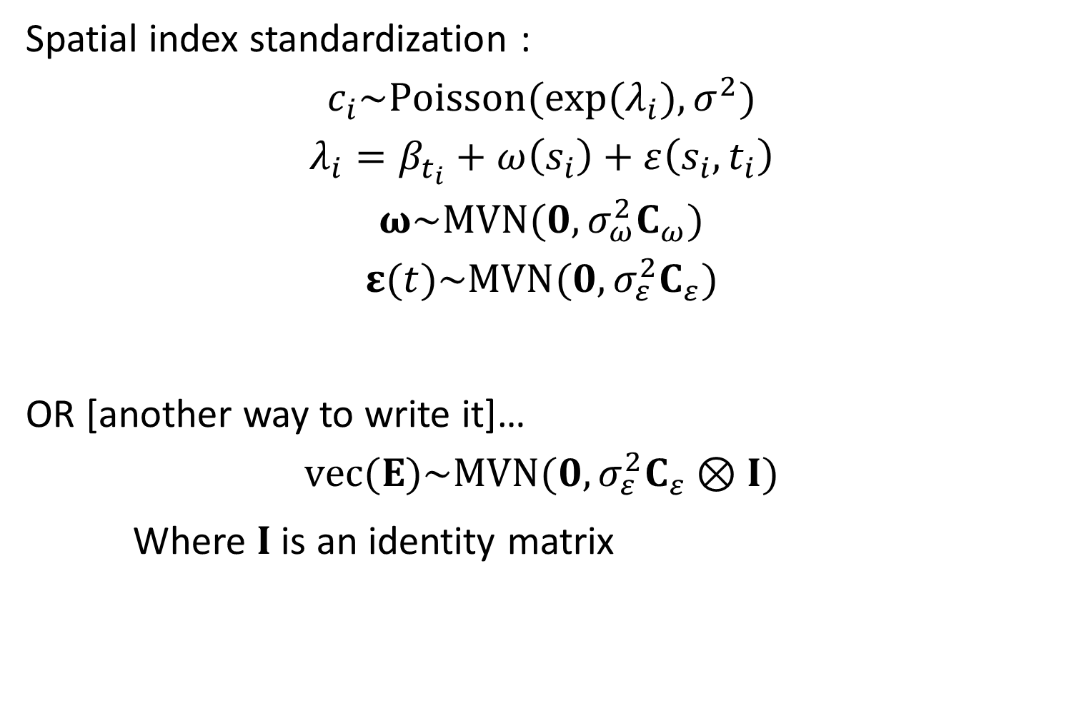
Spatial index standardization :
$$c_{i}\sim Poisson(exp⁡(λ_{i}), σ^{2})$$
$$λ_{i}=β_{t_{i}}+ω\left(s_{i}\right)+ε\left(s_{i},t_{i}\right)$$
$$ω\sim MVN(0,σ_{ω}^{2}C_{ω})$$
$$ε(t)\sim MVN(0,σ_{ε}^{2}C_{ε})$$
OR [another way to write it]…
$$vec(Ε)\sim MVN(0,σ_{ε}^{2}C_{ε}⊗I)$$
Where $I$ is an identity matrix
Notes:
This is another way to write the gam notation

Slide 6
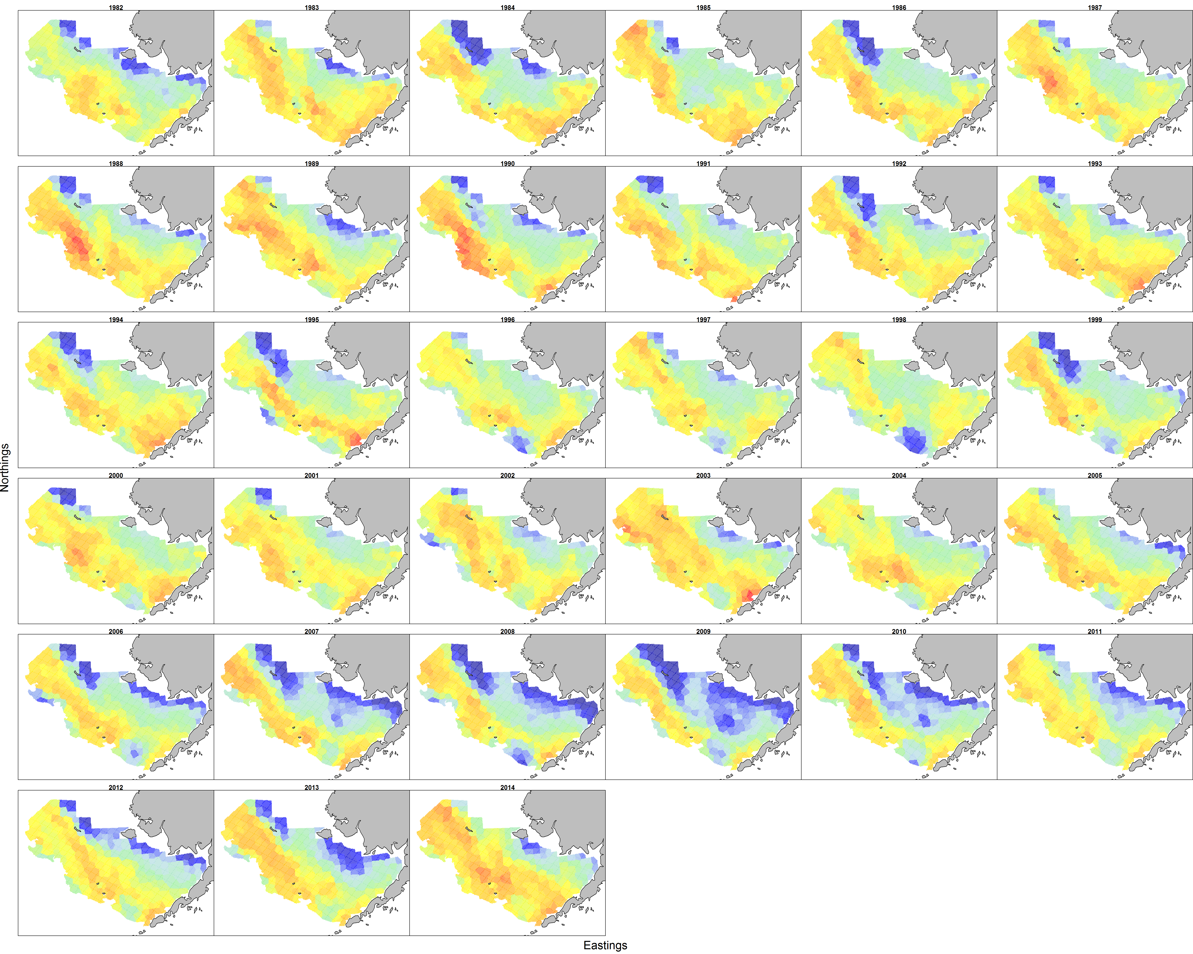
Two we will focus on:
Alaska pollock in the Eastern Bering Sea

Slide 7
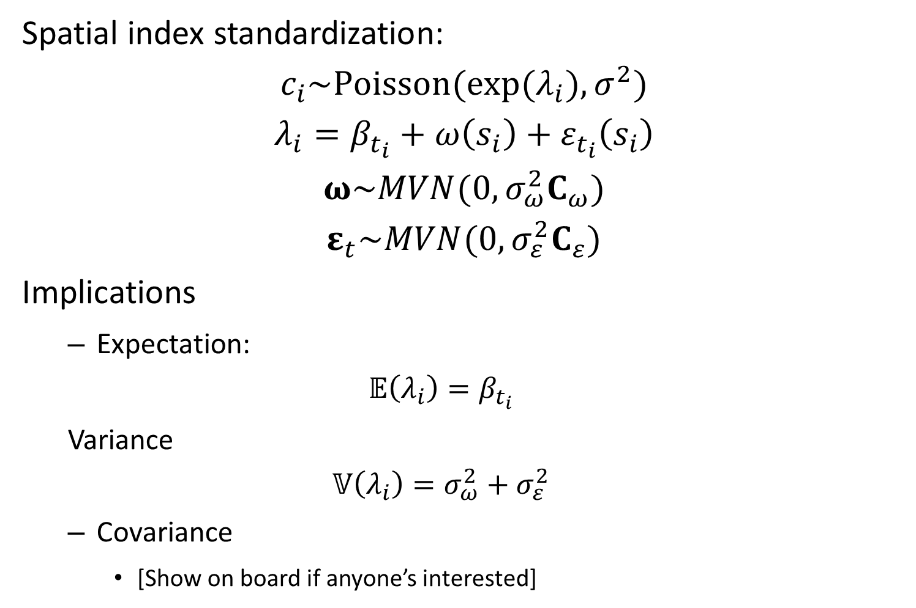
Spatial index standardization:
$$c_{i}\sim Poisson(exp⁡(λ_{i}), σ^{2})$$
$$λ_{i}=β_{t_{i}}+ω\left(s_{i}\right)+ε_{t_{i}}\left(s_{i}\right)$$
$$ω\sim MVN(0,σ_{ω}^{2}C_{ω})$$
$$ε_{t}\sim MVN(0,σ_{ε}^{2}C_{ε})$$
Implications
Expectation:
$$𝔼\left(λ_{i}\right)=β_{t_{i}}$$
Variance
$$𝕍\left(λ_{i}\right)=σ_{ω}^{2}+σ_{ε}^{2}$$
Covariance
[Show on board if anyone’s interested]
Notes:
Variance partitioning – variances sum to 1 in standard linear model
In GLMs – people want to make statements about variance partitioning for appropriate accounting

Slide 8

Spatial index standardization:
$$c_{i}\sim Poisson(exp⁡(λ_{i}), σ^{2})$$
$$λ_{i}=β_{t_{i}}+ω\left(s_{i}\right)+ε_{t_{i}}\left(s_{i}\right)$$
$$ω\sim MVN(0,σ_{ω}^{2}C_{ω})$$
$$ε_{t}\sim MVN(0,σ_{ε}^{2}C_{ε})$$
[Show R script for model]
Notes:
Tau_O = spatial
Tau_E = spatial-temporal

Slide 9
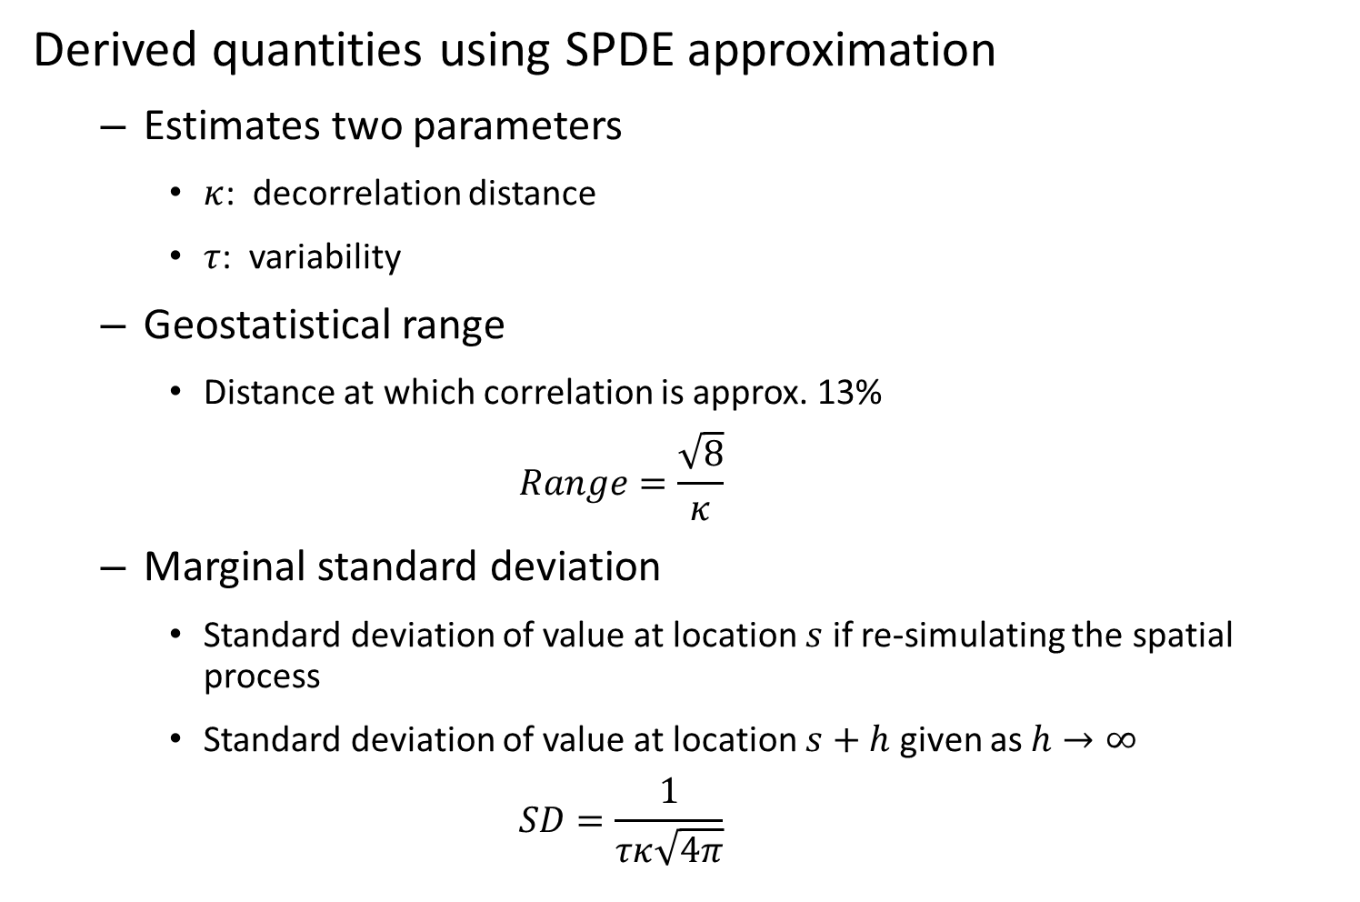
Derived quantities using SPDE approximation
Estimates two parameters
$κ$: decorrelation distance
$τ$: variability
Geostatistical range
Distance at which correlation is approx. 13%
$$Range=\frac{\sqrt{8}}{κ}$$
Marginal standard deviation
Standard deviation of value at location $s$ if re-simulating the spatial process
Standard deviation of value at location $s+h$ given as $h→∞$
$$SD=\frac{1}{τκ\sqrt{4π}}$$

Slide 10
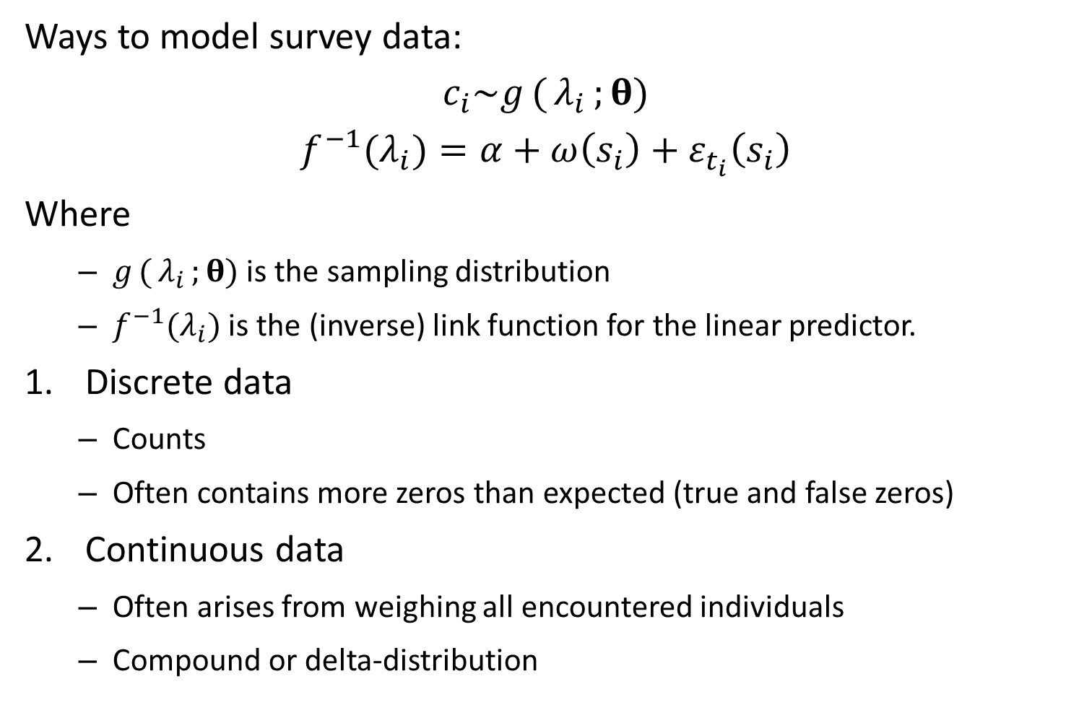
Ways to model survey data:
$$c_{i}\sim g({λ_{i}};θ)$$
$$f^{−1}(λ_{i})=α+ω\left(s_{i}\right)+ε_{t_{i}}\left(s_{i}\right)$$
Where
$g({λ_{i}};θ)$ is the sampling distribution
$f^{−1}(λ_{i})$ is the (inverse) link function for the linear predictor.
Discrete data
Counts
Often contains more zeros than expected (true and false zeros)
Continuous data
Often arises from weighing all encountered individuals
Compound or delta-distribution

Slide 11
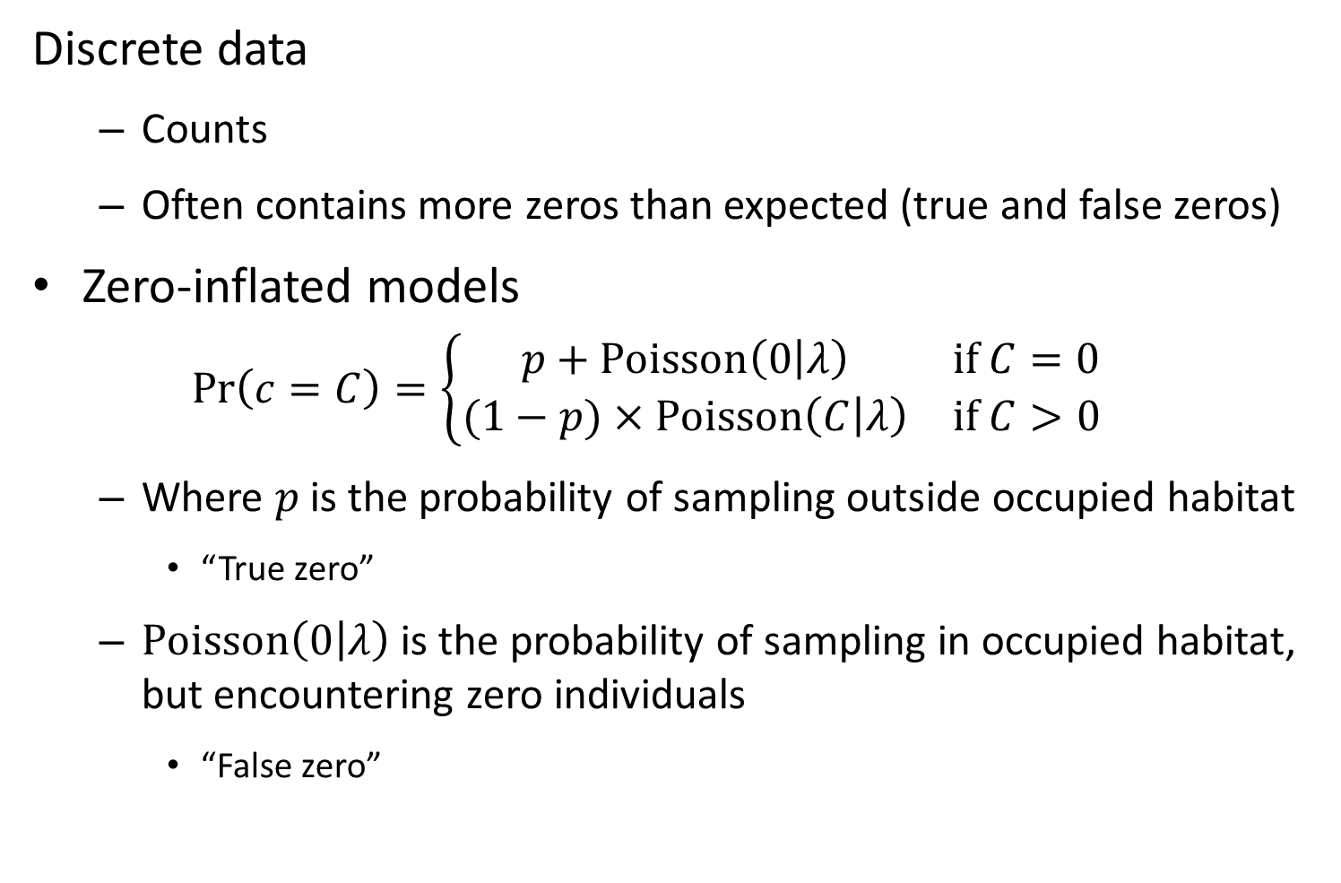
Discrete data
Counts
Often contains more zeros than expected (true and false zeros)
Zero-inflated models
$$\operatorname{Pr}\left(c=C\right)=\left\{\begin{matrix}p+Poisson\left(0 | λ\right) & if C=0 \\ (1−p)×Poisson\left(C | λ\right) & if C>0\end{matrix}\right.$$
Where $p$ is the probability of sampling outside occupied habitat
“True zero”
$Poisson\left(0 | λ\right)$ is the probability of sampling in occupied habitat, but encountering zero individuals
“False zero”

Slide 12
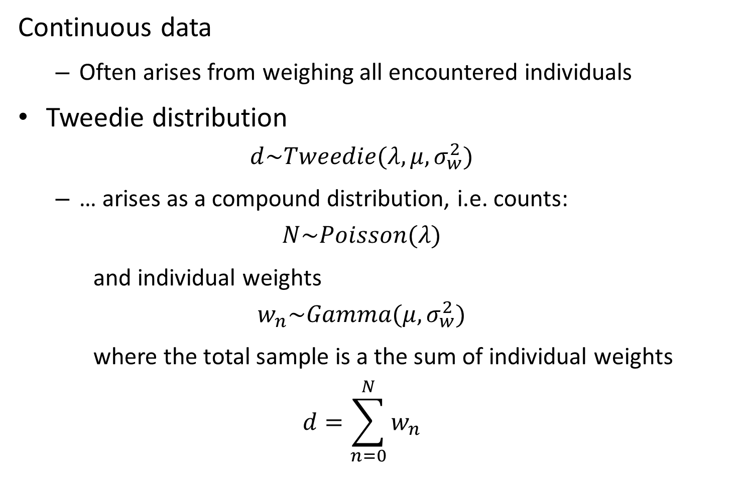
Continuous data
Often arises from weighing all encountered individuals
Tweedie distribution
$$d\sim Tweedie(λ,μ,σ_{w}^{2})$$
… arises as a compound distribution, i.e. counts:
$$N\sim Poisson(λ)$$
and individual weights
$$w_{n}\sim Gamma(μ,σ_{w}^{2})$$
where the total sample is a the sum of individual weights
$$d=\sum_{n=0}^{N}{w_{n}}$$

Slide 13
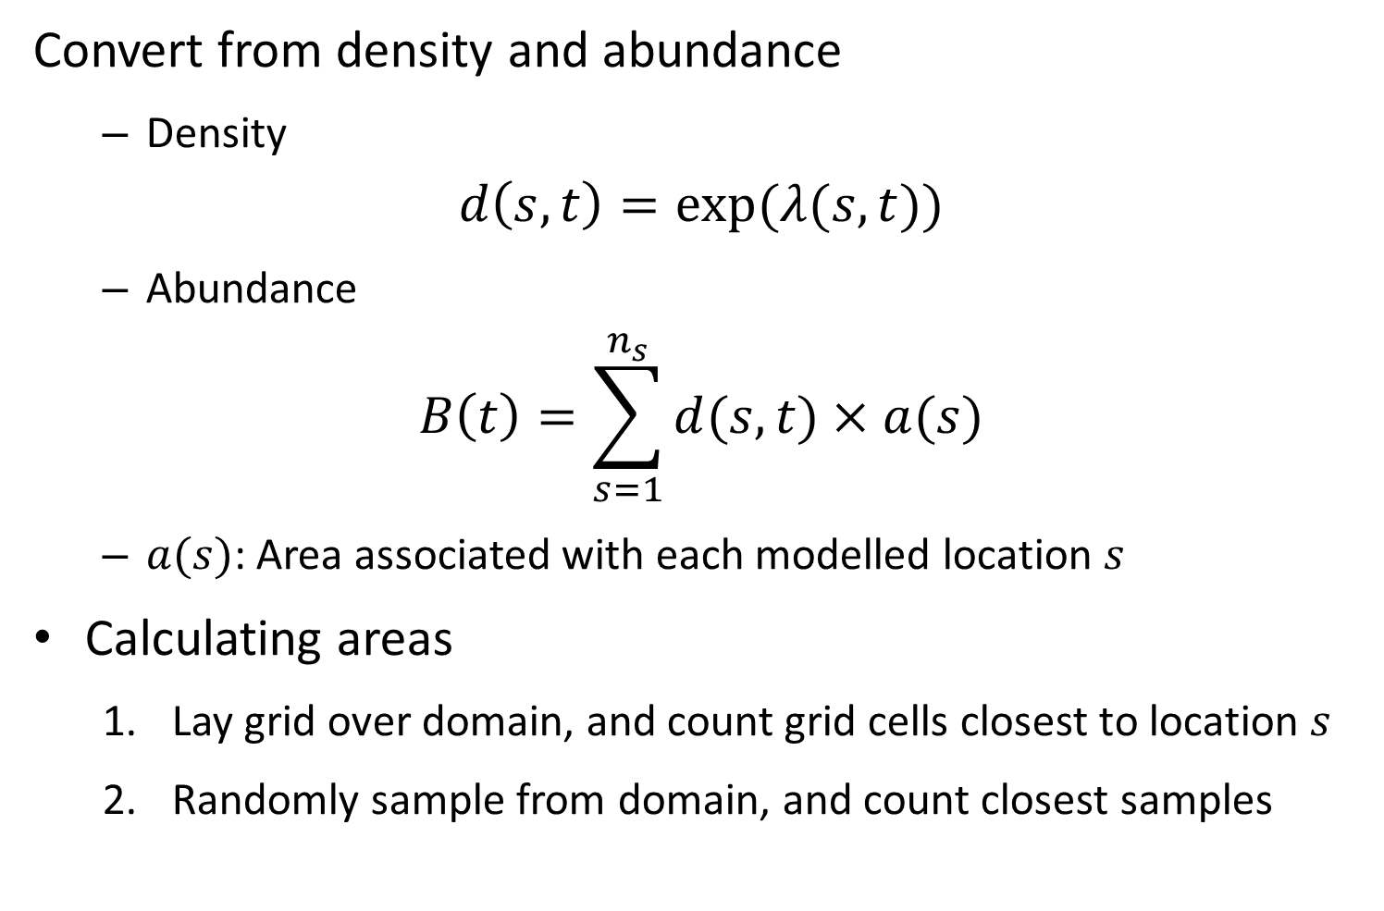
Convert from density and abundance
Density
$$d\left(s,t\right)=exp⁡(λ(s,t))$$
Abundance
$$B\left(t\right)=\sum_{s=1}^{n_{s}}{d(s,t)×a(s)}$$
$a(s)$: Area associated with each modelled location $s$
Calculating areas
Lay grid over domain, and count grid cells closest to location $s$
Randomly sample from domain, and count closest samples

Slide 14

Derived quantities
$$d\left(s,t\right)=exp⁡(λ(s,t))$$
Total abundance
$$B\left(t\right)=\sum_{s=1}^{n_{s}}{d(s,t)×a(s)}$$
Center of gravity
$${\overline{x}}_{t}=\frac{1}{\sum_{s=1}^{n_{s}}{\left(d(s,t)×a(s)\right)}}\sum_{s=1}^{n_{s}}{x(s)\left(d(s,t)×a(s)\right)}$$
Average density
$$\overline{d}\left(t\right)=\frac{1}{\sum_{s=1}^{n_{s}}{\left(d(s,t)×a(s)\right)}}\sum_{s=1}^{n_{s}}{d(s,t)\left(d(s,t)×a(s)\right)}$$
Effective area occupied
$$a_{t}=\frac{B(t)}{\overline{d}\left(t\right)}$$
Notes:
Ideas for project
Center of gravity – are fish moving to warmer temperatures? Are they moving north? Average latitude of a population where you weight by the density at each latitude (weighted average)
Studies of density dependence would work better if we looked at a spatial measure of density dependence and not population
Think about effective area occupied or average density for studies of detecting serial depletion

Slide 15
Exercise
Divide into groups and add total abundance, center-of-gravity, average density, and effective area occupied calculations

